Slide 1
Watch and Chill Demo
Jonathan Manton

Slide 2
Overview
The Watch and Chill project (chiller for short) is a open source project to demonstrate how to set up CI/CD for a kubernetes-based application
The application trivial and is not the focus of this project
3-tier application with web front end, back end services, and a database
The focus is on the activities supporting the development, testing and operation of the application

Slide 3
Links
Application code, CI/CD, Helm chart, load testing
https://github.com/lago-morph/chiller
Documentation
https://github.com/lago-morph/chiller-doc
IaC (minimal prototype only)
https://github.com/lago.morph/chiller-iac

Slide 4
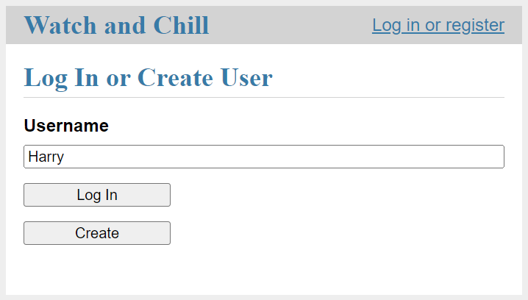
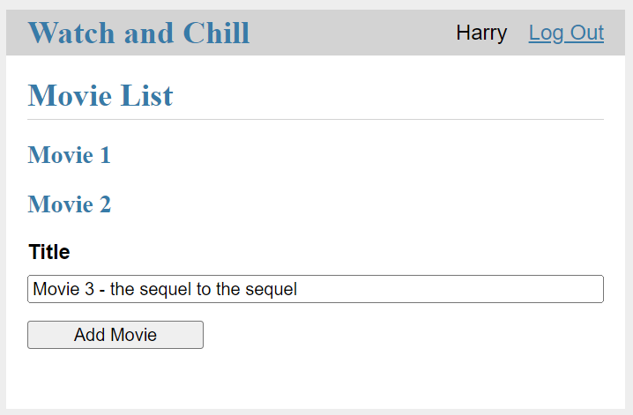
Application trivially simple

Slide 5
Components
Application – requirements and design for the application
API definition – OpenAPI specification and code generation for back end services and Python SDK
Development platform – Instructions for how to set up and use the development environment
Developer testing – Instructions for how to manually run tests (unit, integration, browser), as well as for convenience Makefile scripts
CI/CD – Structure of the continuous integration, delivery, and deployment system
IaC – Terraform code for maintaining the production cloud environment
Application install – Helm chart for application installation
Observability (metrics) – Documentation and install scripts for Prometheus Operator and Grafana
Load testing – Documentation and instructions for running load tests with Locust
Future – Observability (logs) and Observability (tracing) are planned but not currently designed

Slide 6
Status – not all complete
Component | Status
Application | 🟢 Complete
API definition | 🟢 Complete
Development platform | 🟢 Complete
Developer testing | 🟢 Complete
CI/CD Overview | 🟢 Complete
Continuous integration (CI) | 🟢 Complete
Continuous delivery (CDel) | 🟢 Complete
Continuous deployment (CDep) | 🟠 Designed
IaC - environment setup | 🟡 In process
Application install | 🟡 In process
Observability - metrics | 🟡 In process
Load testing | 🟡 In process
Observability - tracing | 🔴 Not started
Observability - logs | 🔴 Not started

Slide 7
Possible topics
Demos
CI/CDdelivery
Application install and Helm chart
Observability (metrics) – Prometheus Operator and Grafana config
Load testing – Selenium (slow but accurate), Locust (fast)
Code only
OpenAPI definition and code generation
Developer testing – pre-CI
Continuous deployment design
IaC prototype

Slide 8
Backup slides

Slide 9
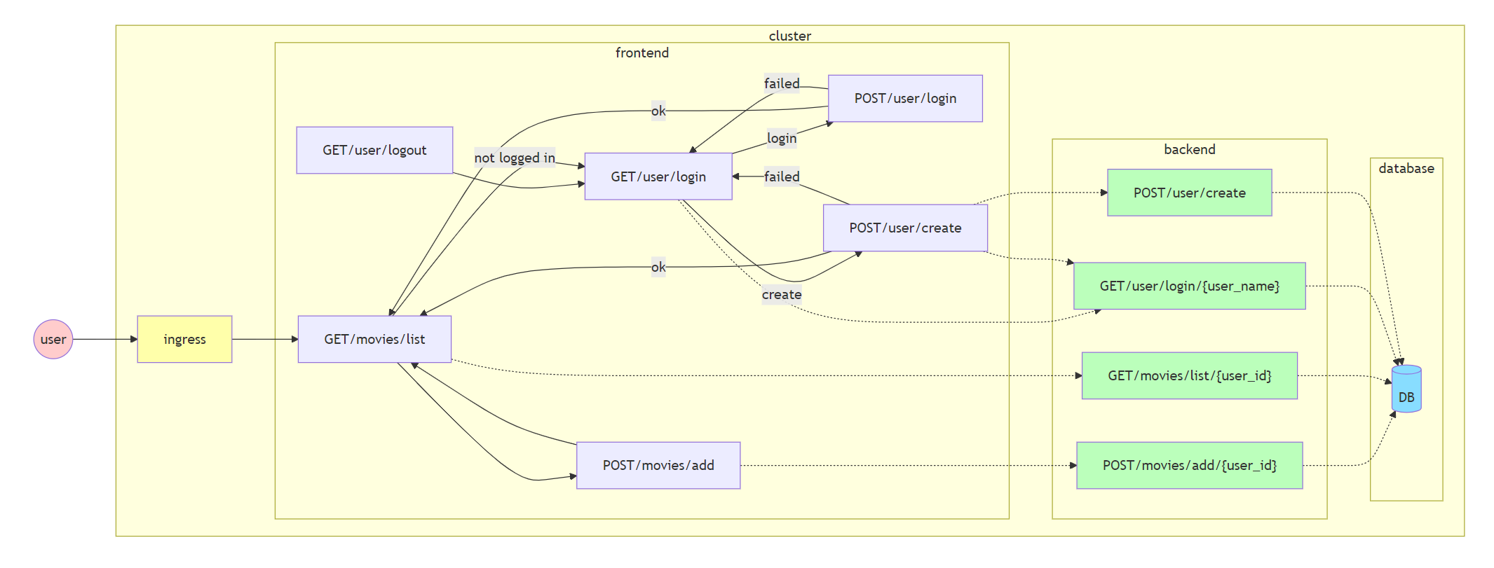
Application flow

Slide 10
CI/CD Components
Overview
Branching
Pull requests
Merging
CI/CD system integration with GitHub
Continuous Integration (CI)
GitHub Actions
What tests are run
Event triggers
Continuous Delivery (CDel)
GitHub Actions
Container build process, tagging, and storage
GitHub labels to integrate with CDep
Continuous Deployment (CDep) – design only
Automated deployment tests
Production deployment
Post-deployment monitoring and automatic rollback (if necessary)

Slide 11
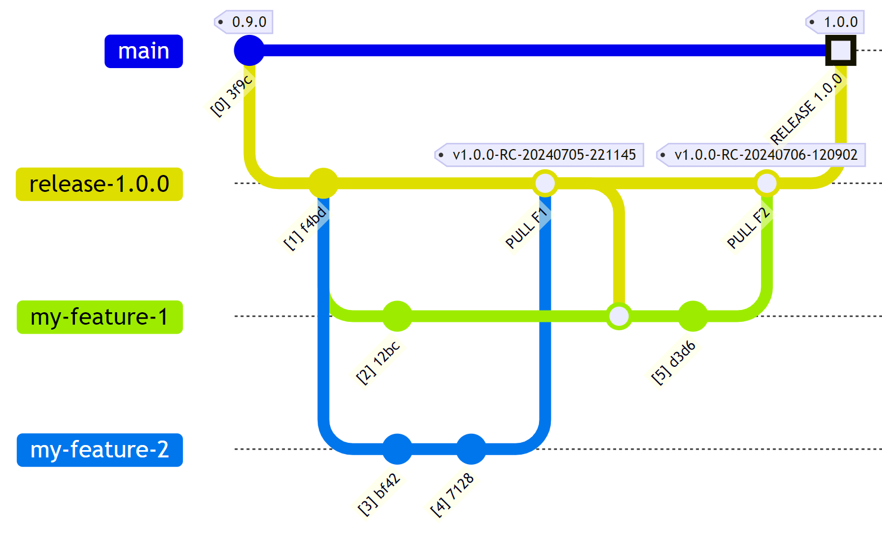
Branching strategy and CI/CD
Approve pull request for main branch CDep to production triggered
Create pull request for main branch CDep testing triggered
Approve pull request for release branch CDel triggered
Create pull request for release branch CI triggered

Slide 12
Prometheus metrics flow from application
Chiller application pod
ServiceMonitor resources and exporter sidecars configured in Helm chart
Prometheus Operator
Push metrics
Application
Gunicorn
(StatsD)
Pull metrics
statsd-exporter
ServiceMonitor Custom Resource Definition (CRD)
Kubernetes sidecar translates metrics from StatsD (push) to Prometheus (pull) format and remaps names
Configures Prometheus Operator
Similar structure with PostgreSQL
Uses postgres-exporter to collect metrics

